Slide 1
CSCE 823 In Class Day 04
Artificial Neural Networks
(aka Multilayer Perceptrons)
Live Synchronous session

Slide 2
Agenda
Key points for ANNs
Break
Learning Activity: ANNs
HW Introduction

Slide 3
Key points for ANNs
Modeling nonlinear functions
Forward propagation
Backprop intuition
Training and Best Practices

Slide 4
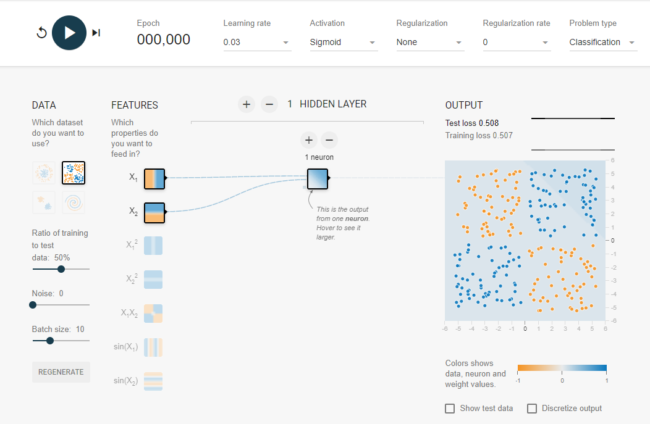
Perceptrons v. ANNs with nonlinear function modeling
Perceptrons can only model linear functions (e.g. cannot model XOR)
With enough capacity, ANNs can model arbitrary functions
Individual Activity: https://playground.tensorflow.org/
Step 1: Perceptron
Step 2: Minimal capacity ANN
Step 3: Higher-capacity ANN

Slide 5
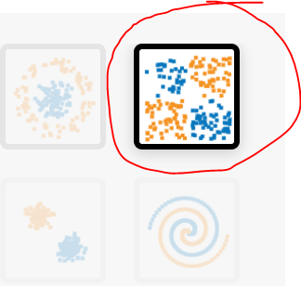

Function Modeling of XOR: Perceptron
Step 1.1: Build 1 perceptron node for classification
“1 hidden layer”; Sigmoid Activation
Leave other settings default
Step 1.2: train for 1k epochs
Does it work?

Slide 6
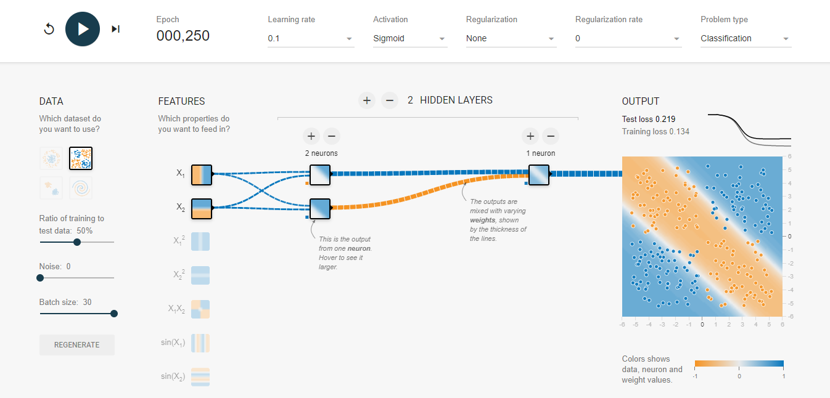
XOR: with minimal ANN
Step 2.1: Build Smallest ANN for XOR classification
“2 hidden layer”; Sigmoid Activation
Leave other settings default
Step 2.2: train for 1k epochs
Does it work?
What do we observe?

Slide 7
XOR: with minimal ANN
Minimal capacity networks are difficult to train and highly dependent on initial conditions of the weights and biases
Step 2.3: It is possible: Try initializing with
1 for the input multipliers
+0.6 for the top node bias
-1.4 for the bottom node bias
-1 for the top 2nd hidden mult
+1 for the bottom 2nd hidden mult
-0.4 for the output bias

Slide 8
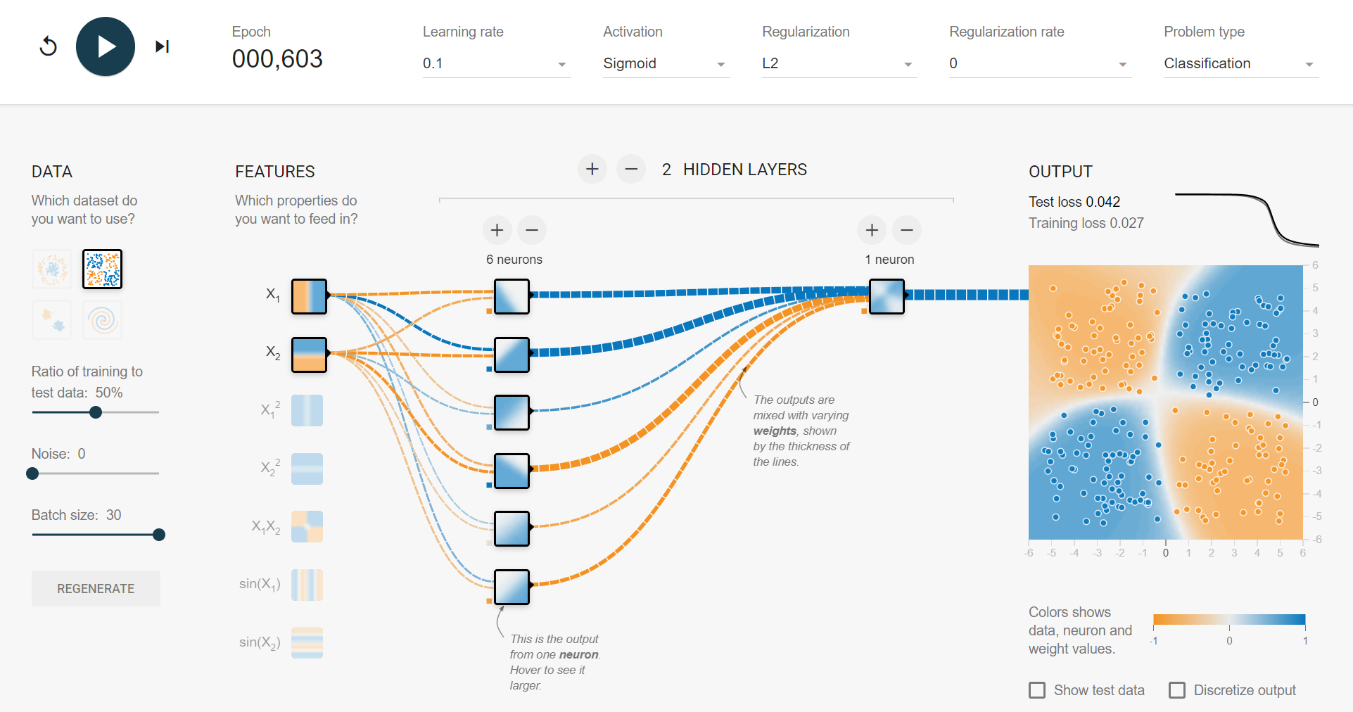
XOR with higher than minimal capacity ANN
Step 3.1: Build Larger ANN for XOR classification
“2 hidden layer w 2+ nodes in 1st hidden layer” (incrementally add nodes)
Sigmoid Activation
Leave other settings default
Step 3.2: train for 1k epochs
Does it work?
If not, consider adding another hidden layer
What do we observe about the ability to train the network as we add nodes/layers?

Slide 9
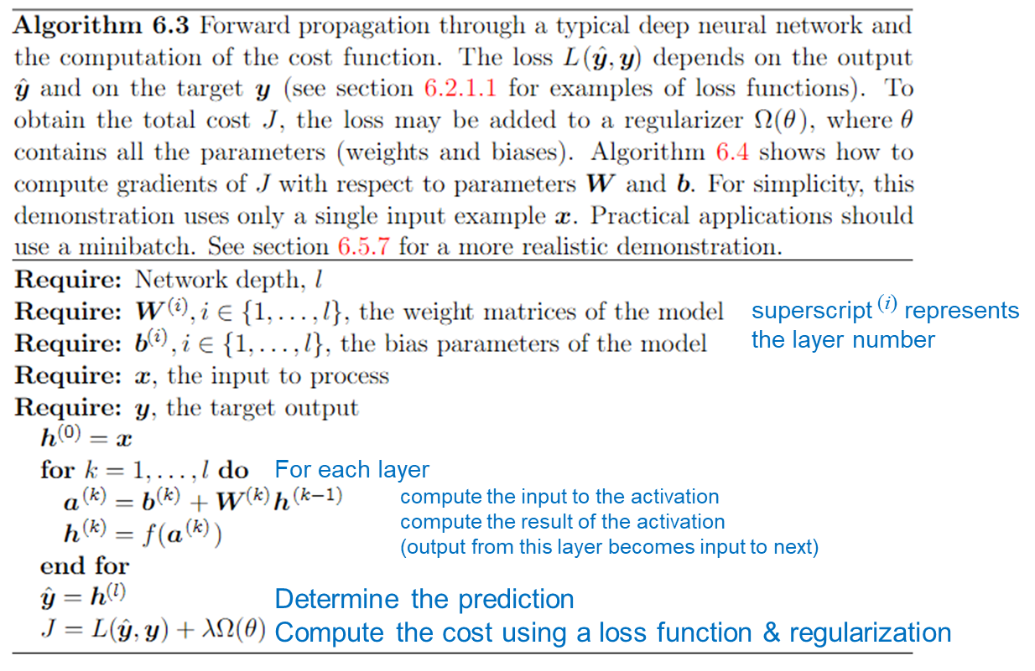
Forward propagation
Forward propagation: In the ANN an input is fed to the network and an output is computed
Each layer’s output becomes input to next layer
Cost = sum of loss and regularization penalty:
Loss function accounts for prediction error
Regularization function penalizes parameters (reduce model variance)

Slide 10
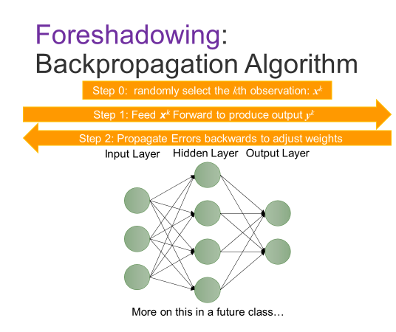
Backprop Intuition
Forward prop makes a prediction
The amount of error in the prediction should be accounted for by adjusting model parameters (weights and biases)
The amount of error a node is responsible for is related to the amount of activation it had on that input
The amount of change to a node parameter will be affected by the gradient of the activation with respect to the parameter AT the value of the activation induced by the input

Slide 11
Training and Best Practices
Normalize inputs (data mean should be close to zero)
Build a network large enough to shatter (memorize) the training set when no regularization is used
Then use regularization to reduce likelihood of overfitting
Increased regularization might require higher learning rate
Use as big a minibatch as can fit on your hardware (more stable training)
Monitor Training and Val Performance
Use ValSet
If you monitor training and validation performance, what would you expect to see these two measures do as the network continues to train?
Given the above, when should you stop training?

Slide 12
Break

Slide 13
Learning Activity- ANN for XOR w/human-decided parameters
Breakout/Small Group for 15 minutes:
Obtain the zip file with code and instructions
Complete the code required to make forward propagation
Compute the net from the layer inputs, weights and biases
Compute the result of the activation on the net
Select a set of weights and biases for the network
Use the excel spreadsheet if it helps
Evaluate your choices

Slide 14
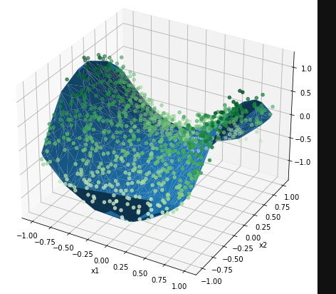
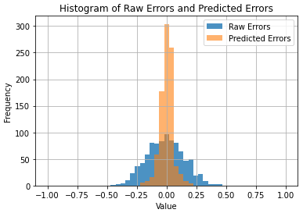
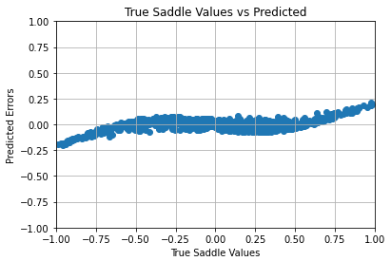
Post-class coding activity (HW) intro
Building an ANN regression model for the saddle dataset

Slide 15
Q&A

